Slide 1
Hidden Markov Model
Il-Chul Moon
Dept. of Industrial and Systems Engineering
KAIST
icmoon@kaist.ac.kr

Slide 2
Weekly Objectives
Learn hidden Markov model
  Transition from the static clustering to the dynamic clustering
  Understand the difference of the graphical model
Know and able to answer the three major questions of HMM
  Know how to solve the evaluation question
  Know how to solve the decoding question
  Know how to solve the learning question
Link to the previous lectures
  Link the forward-backward algorithm to the message passing
  Link the baum-welch algorithm to the EM algorithm

Slide 3
Forward-backward probability

Slide 4

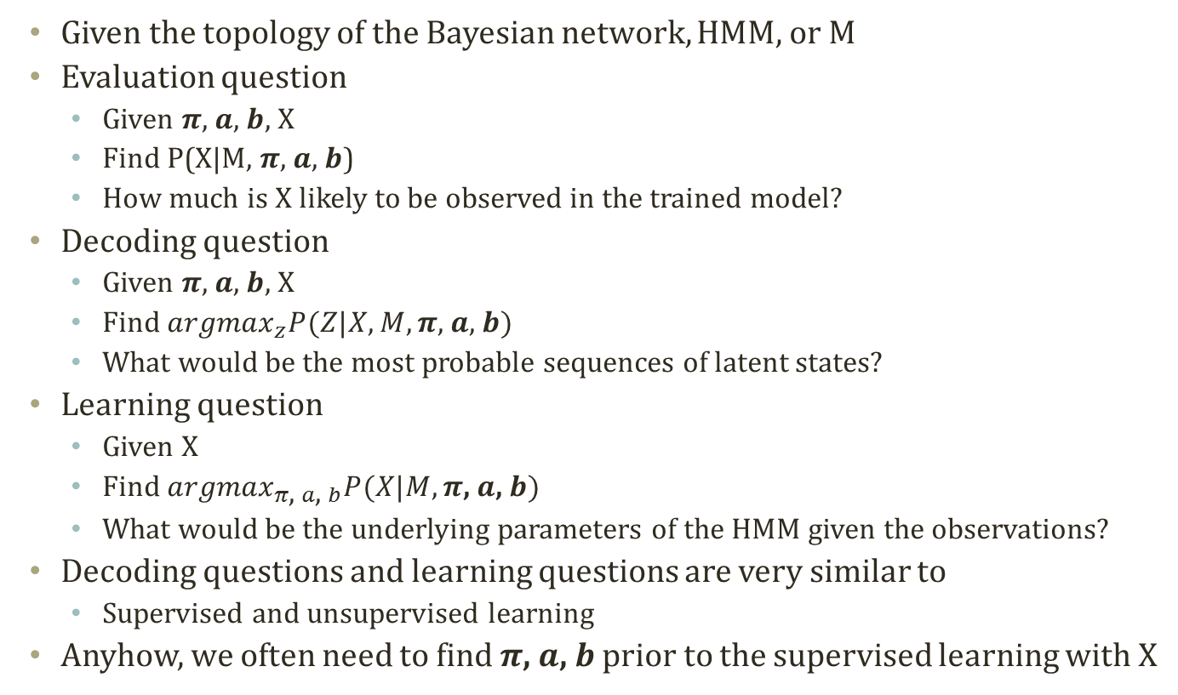
Main Questions on HMM
Initial State probabilities
  $$P(z_{1})∼Mult(π_{1},…,π_{k})$$
Transition probabilities
  $$P(z_{t}|z_{t−1}^{i}=1)∼Mult(a_{i,1},…,a_{i,k})$$
  Or, $P\left(z_{t}^{j}=1 | z_{t−1}^{i}=1\right)=a_{i,j}$
Emission probabilities
  $$P(x_{t}|z_{t}^{i}=1)∼Mult(b_{i,1},…,b_{i,m})∼f(x_{t}|θ_{i})$$
  Or, $P\left(x_{t}^{j}=1 | z_{t}^{i}=1\right)=b_{i,j}$
Given the topology of the Bayesian network, HMM, or M
Evaluation question
  Given $π$, $a$, $b$, X
  Find P(X|M, $π$, $a$, $b$)
  How much is X likely to be observed in the trained model?
Decoding question
  Given $π$, $a$, $b$, X
  Find ${argmax}_{z}P(Z|X,M,π\text{, }a\text{, }b)$
  What would be the most probable sequences of latent states?
Learning question
  Given X
  Find ${argmax}_{π\text{, }a\text{, }b}P(X|M,π\text{, }a\text{, }b)$
  What would be the underlying parameters of the HMM given the observations?
Decoding questions and learning questions are very similar to
  Supervised and unsupervised learning
Anyhow, we often need to find $π\text{, }a\text{, }b$ prior to the supervised learning with X

Slide 5
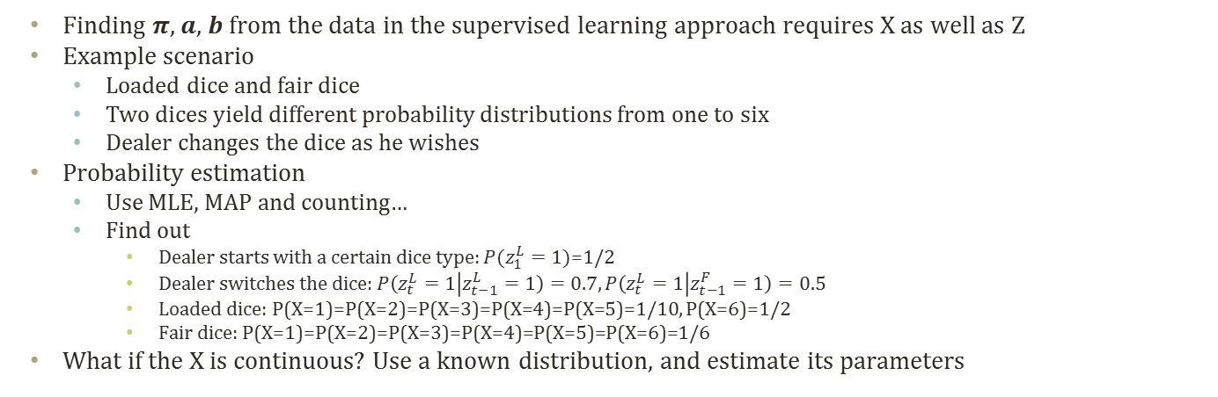


Obtaining $π$, $a$, $b$ given X and M
Initial State probabilities
  $$P(z_{1})∼Mult(π_{1},…,π_{k})$$
Transition probabilities
  $$P(z_{t}|z_{t−1}^{i}=1)∼Mult(a_{i,1},…,a_{i,k})$$
  Or, $P\left(z_{t}^{j}=1 | z_{t−1}^{i}=1\right)=a_{i,j}$
Emission probabilities
  $$P(x_{t}|z_{t}^{i}=1)∼Mult(b_{i,1},…,b_{i,m})∼f(x_{t}|θ_{i})$$
  Or, $P\left(x_{t}^{j}=1 | z_{t}^{i}=1\right)=b_{i,j}$
LLLLLLLFFFFFFFF
12342531643242
……………
FFFLLFLFLFLLLLFLLLFL
3526152436152436152
Counting, MLE, MAP…
$$π$$
z1
z2
z3
N
seq.
x1
x2
x3
M_{i} observations for i-th sequence
Finding $π$, $a$, $b$ from the data in the supervised learning approach requires X as well as Z
Example scenario
  Loaded dice and fair dice
  Two dices yield different probability distributions from one to six
  Dealer changes the dice as he wishes
Probability estimation
  Use MLE, MAP and counting…
  Find out
    Dealer starts with a certain dice type: $P(z_{1}^{L}=1)\text{=1/}\text{2}$
    Dealer switches the dice: $P\left(z_{t}^{L}=1 | z_{t−1}^{L}=1\right)=0.7,P\left(z_{t}^{L}=1 | z_{t−1}^{F}=1\right)=0.5$
    Loaded dice: P(X=1)=P(X=2)=P(X=3)=P(X=4)=P(X=5)=1/10, P(X=6)=1/2
    Fair dice: P(X=1)=P(X=2)=P(X=3)=P(X=4)=P(X=5)=P(X=6)=1/6
What if the X is continuous? Use a known distribution, and estimate its parameters

Slide 6

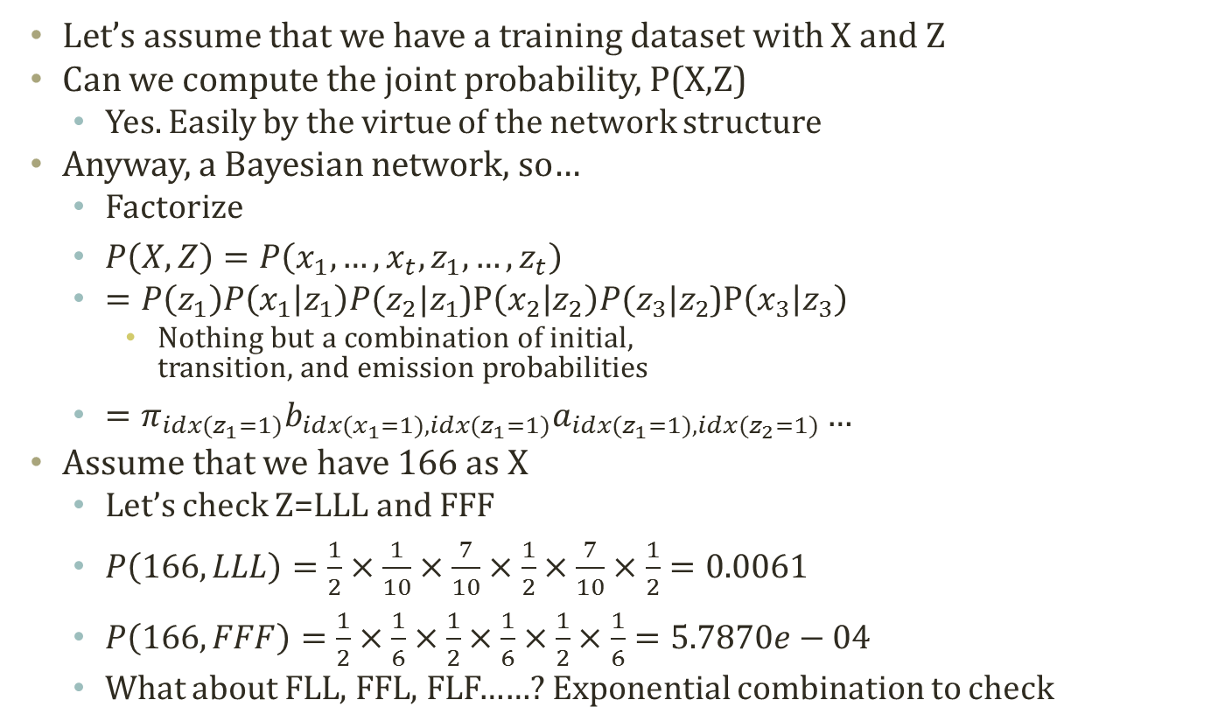

Joint Probability
Initial State probabilities
  $$P(z_{1})∼Mult(π_{1},…,π_{k})$$
Transition probabilities
  $$P(z_{t}|z_{t−1}^{i}=1)∼Mult(a_{i,1},…,a_{i,k})$$
  Or, $P\left(z_{t}^{j}=1 | z_{t−1}^{i}=1\right)=a_{i,j}$
Emission probabilities
  $$P\left(x_{t} | z_{t}^{i}=1\right)∼Mult\left(b_{i,1},…,b_{i,m}\right)$$
  Or, $P\left(x_{t}^{j}=1 | z_{t}^{i}=1\right)=b_{i,j}$
LLLLLLLFFFFFFFF
12342531643242
……………
FFFLLFLFLFLLLLFLLLFL
3526152436152436152
N
seq.
M_{i} observations for i-th sequence
Let’s assume that we have a training dataset with X and Z
Can we compute the joint probability, P(X,Z)
  Yes. Easily by the virtue of the network structure
Anyway, a Bayesian network, so…
  Factorize
  $P\left(X,Z\right)=P\left(x_{1},…,x_{t},z_{1},…,z_{t}\right)$
  $=P\left(z_{1}\right)P\left(x_{1} | z_{1}\right)P(z_{2}|z_{1}$)P$\left(x_{2} | z_{2}\right)P(z_{3}|z_{2}$)P$\left(x_{3} | z_{3}\right)$
    Nothing but a combination of initial,
    transition, and emission probabilities
  $=π_{idx(z_{1}=1)}b_{idx(x_{1}=1),idx(z_{1}=1)}a_{idx(z_{1}=1),idx(z_{2}=1)}…$
Assume that we have 166 as X
  Let’s check Z=LLL and FFF
  $P\left(166,LLL\right)=\frac{1}{2}×\frac{1}{10}×\frac{7}{10}×\frac{1}{2}×\frac{7}{10}×\frac{1}{2}=0.0061$
  $P\left(166,FFF\right)=\frac{1}{2}×\frac{1}{6}×\frac{1}{2}×\frac{1}{6}×\frac{1}{2}×\frac{1}{6}=5.7870e−04$
  What about FLL, FFL, FLF……? Exponential combination to check
$$π$$
z1
z2
z3
x1
x2
x3

Slide 7
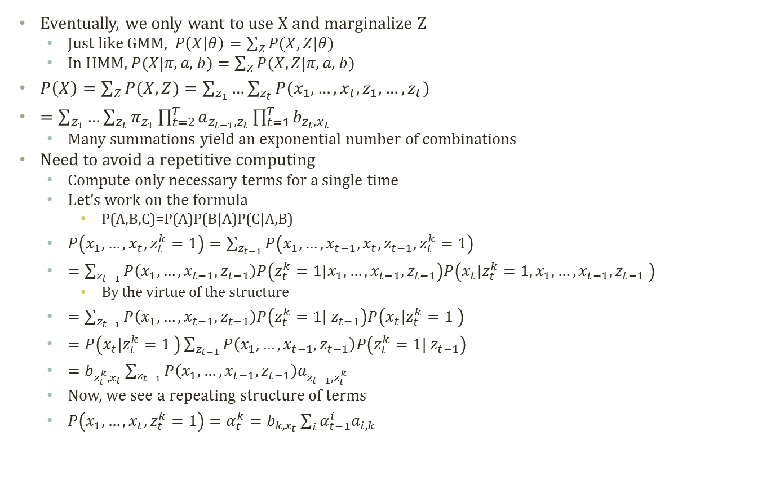

Marginal
Probability
Initial State probabilities
  $$P(z_{1})∼Mult(π_{1},…,π_{k})$$
Transition probabilities
  $$P(z_{t}|z_{t−1}^{i}=1)∼Mult(a_{i,1},…,a_{i,k})$$
  Or, $P\left(z_{t}^{j}=1 | z_{t−1}^{i}=1\right)=a_{i,j}$
Emission probabilities
  $$P\left(x_{t} | z_{t}^{i}=1\right)∼Mult\left(b_{i,1},…,b_{i,m}\right)$$
  Or, $P\left(x_{t}^{j}=1 | z_{t}^{i}=1\right)=b_{i,j}$
LLLLLLLFFFFFFFF
12342531643242
……………
FFFLLFLFLFLLLLFLLLFL
3526152436152436152
N
seq.
M_{i} observations for i-th sequence
Eventually, we only want to use X and marginalize Z
  Just like GMM, $P\left(X | θ\right)=\sum_{Z}{P(X,Z|θ)}$
  In HMM, $P(X|π\text{, }a\text{, }b)=\sum_{Z}{P(X,Z|π\text{, }a\text{, }b)}$
$P\left(X\right)=\sum_{Z}{P(X,Z)}=\sum_{z_{1}}{…\sum_{z_{t}}{P(x_{1},…,x_{t},z_{1},…,z_{t})}}$
$=\sum_{z_{1}}{…\sum_{z_{t}}{π_{z_{1}}\prod_{t=2}^{T}{a_{z_{t−1},z_{t}}}\prod_{t=1}^{T}{b_{z_{t},x_{t}}}}}$
  Many summations yield an exponential number of combinations
Need to avoid a repetitive computing
  Compute only necessary terms for a single time
  Let’s work on the formula
    P(A,B,C)=P(A)P(B|A)P(C|A,B)
  $P\left(x_{1},…,x_{t}, z_{t}^{k}=1\right)=\sum_{z_{t−1}}{P\left(x_{1},…,x_{t−1},x_{t},z_{t−1},z_{t}^{k}=1\right)}$
  $=\sum_{z_{t−1}}{P\left(x_{1},…,x_{t−1}, z_{t−1}\right)P\left(z_{t}^{k}=1|x_{1},…,x_{t−1}, z_{t−1}\right)P\left(x_{t}|z_{t}^{k}=1, x_{1},…,x_{t−1},z_{t−1} \right)}$
    By the virtue of the structure
  $=\sum_{z_{t−1}}{P\left(x_{1},…,x_{t−1}, z_{t−1}\right)P\left(z_{t}^{k}=1| z_{t−1}\right)P\left(x_{t}|z_{t}^{k}=1 \right)}$
  $=P\left(x_{t}|z_{t}^{k}=1 \right)\sum_{z_{t−1}}{P\left(x_{1},…,x_{t−1}, z_{t−1}\right)P\left(z_{t}^{k}=1| z_{t−1}\right)}$
  $=b_{z_{t}^{k},x_{t}}\sum_{z_{t−1}}{P\left(x_{1},…,x_{t−1}, z_{t−1}\right)a_{z_{t−1},z_{t}^{k}}}$
  Now, we see a repeating structure of terms
  $P\left(x_{1},…,x_{t}, z_{t}^{k}=1\right)=α_{t}^{k}=b_{k,x_{t}}\sum_{i}{α_{t−1}^{i}a_{i,k}}$
$$π$$
z1
z2
z3
x1
x2
x3

Slide 8
Detour: Dynamic Programming
F(4)
Dynamic programming:
  A general algorithm design technique for solving problems defined by or formulated as recurrences with overlapping sub-instances
  In this context, Programming == Planning
Main storyline
  Setting up a recurrence
    Relating a solution of a larger instance to solutions of some smaller instances
    Solve small instances once
    Record solutions in a table
    Extract a solution of a larger instance from the table
F(3)
F(2)
F(2)
F(1)
F(1)
F(1)
F(0)
F(0)
Instance | Solution
F(0) | 0
F(1) | 1
F(2) | 1
F(3) | 2
F(4) | ?

Slide 9
Detour: Memoization
Key technique of dynamic programming
  Simply put
    Storing the results of previous function calls to reuse the results again in the future
  More philosophical sense
    Bottom-up approach for problem-solving
      Recursion: Top-down of divide and conquer
      Dynamic programming: Bottom-up of storing and building
Stackframe
Memoization
F(4)
Recursion
Instance | Solution
F(0) | 0
F(1) | 1
F(2) | 1
F(3) | 2
F(4) | 3
F(3)
F(2)
Dynamic
Programming
n
2
R.A
F(2)
F(1)
n
3
F(1)
F(1)
F(0)
R.A
n
4
F(0)
R.A

Slide 10

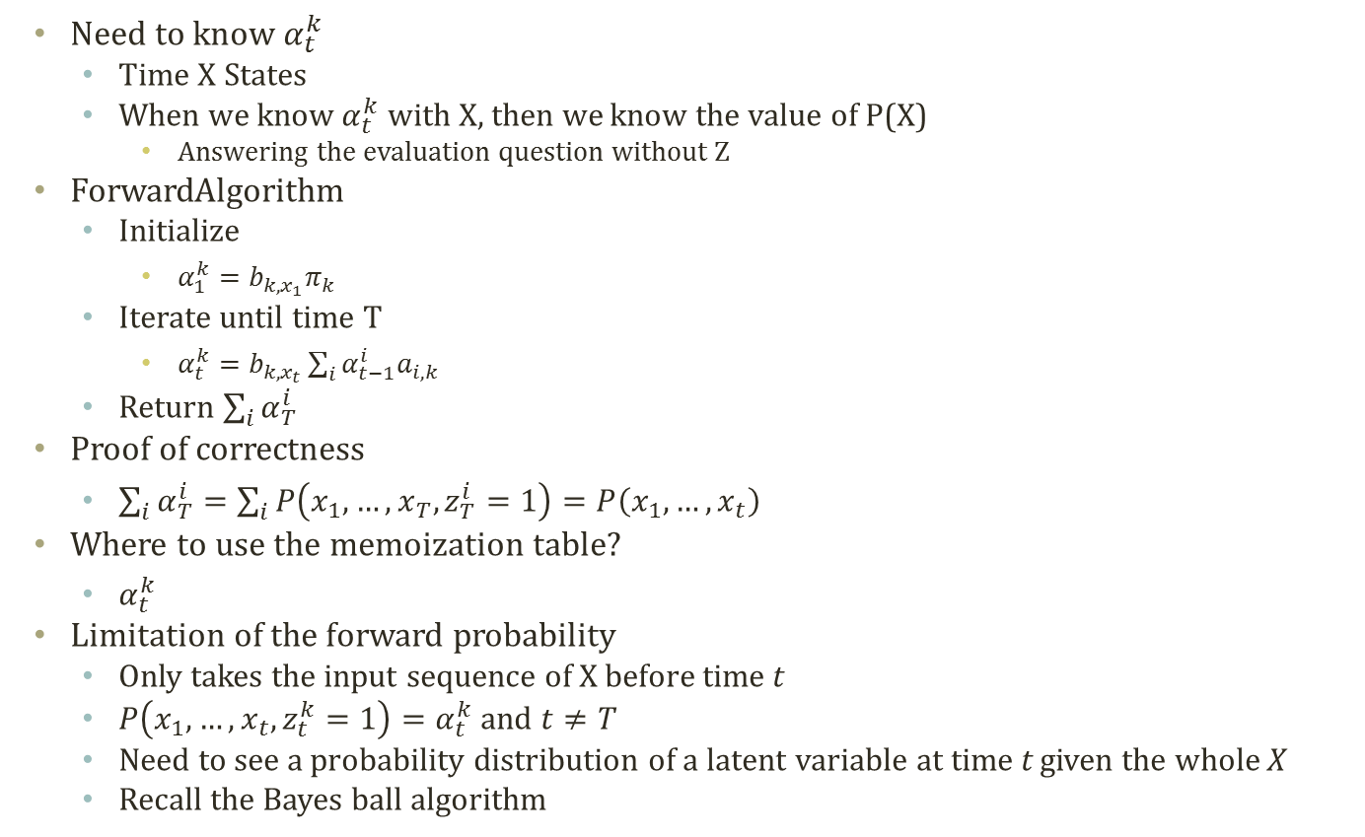
Forward Probability Calculation
Need to know $α_{t}^{k}$
  Time X States
  When we know $α_{t}^{k}$ with X, then we know the value of P(X)
    Answering the evaluation question without Z
ForwardAlgorithm
  Initialize
    $α_{1}^{k}=b_{k,x_{1}}π_{k}$
  Iterate until time T
    $α_{t}^{k}=b_{k,x_{t}}\sum_{i}{α_{t−1}^{i}a_{i,k}}$
  Return $\sum_{i}{α_{T}^{i}}$
Proof of correctness
  $\sum_{i}{α_{T}^{i}}=\sum_{i}{P\left(x_{1},…,x_{T}, z_{T}^{i}=1\right)}=P\left(x_{1},…,x_{t}\right)$
Where to use the memoization table?
  $α_{t}^{k}$
Limitation of the forward probability
  Only takes the input sequence of X before time t
  $P\left(x_{1},…,x_{t}, z_{t}^{k}=1\right)=α_{t}^{k}$ and $t≠T$
  Need to see a probability distribution of a latent variable at time t given the whole X
  Recall the Bayes ball algorithm
Iteration Direction == Forward
$$π$$
z1
z2
z3
x1
x2
x3

Slide 11

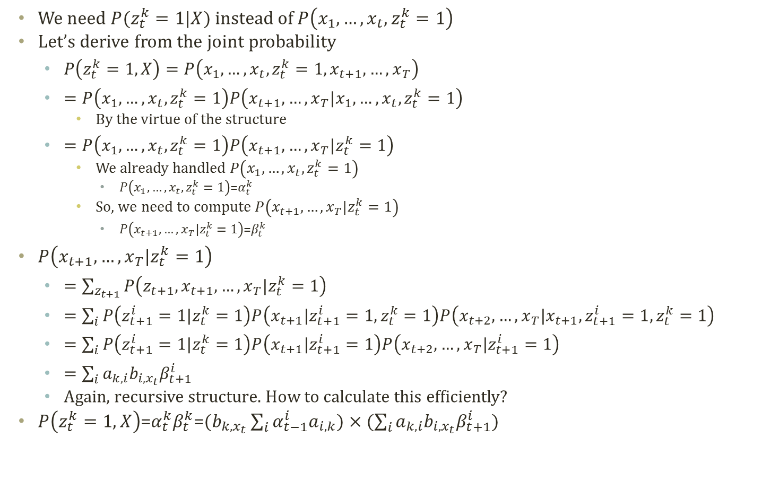
Backward Probability Calculation
We need $P(z_{t}^{k}=1|X)$ instead of $P\left(x_{1},…,x_{t}, z_{t}^{k}=1\right)$
Let’s derive from the joint probability
  $P\left(z_{t}^{k}=1,X\right)=P\left(x_{1},…,x_{t},z_{t}^{k}=1,x_{t+1},…,x_{T}\right)$
  $=P\left(x_{1},…,x_{t},z_{t}^{k}=1\right)P\left(x_{t+1},…,x_{T}|x_{1},…,x_{t},z_{t}^{k}=1\right)$
    By the virtue of the structure
  $=P\left(x_{1},…,x_{t},z_{t}^{k}=1\right)P\left(x_{t+1},…,x_{T}|z_{t}^{k}=1\right)$
    We already handled $P\left(x_{1},…,x_{t},z_{t}^{k}=1\right)$
      $P\left(x_{1},…,x_{t},z_{t}^{k}=1\right)$=$α_{t}^{k}$
    So, we need to compute $P\left(x_{t+1},…,x_{T}|z_{t}^{k}=1\right)$
      $P\left(x_{t+1},…,x_{T}|z_{t}^{k}=1\right)\text{=}β_{t}^{k}$
$P\left(x_{t+1},…,x_{T}|z_{t}^{k}=1\right)$
  $=\sum_{z_{t+1}}{P\left(z_{t+1},x_{t+1},…,x_{T}|z_{t}^{k}=1\right)}$
  $=\sum_{i}{P\left(z_{t+1}^{i}=1|z_{t}^{k}=1\right)P\left(x_{t+1}|z_{t+1}^{i}=1,z_{t}^{k}=1\right)P\left(x_{t+2},…,x_{T}|x_{t+1},z_{t+1}^{i}=1,z_{t}^{k}=1\right)}$
  $=\sum_{i}{P\left(z_{t+1}^{i}=1|z_{t}^{k}=1\right)P\left(x_{t+1}|z_{t+1}^{i}=1\right)P\left(x_{t+2},…,x_{T}|z_{t+1}^{i}=1\right)}$
  $=\sum_{i}{a_{k,i}b_{i,x_{t}}β_{t+1}^{i}}$
  Again, recursive structure. How to calculate this efficiently?
$P\left(z_{t}^{k}=1,X\right)$=$α_{t}^{k}β_{t}^{k}$=$(b_{k,x_{t}}\sum_{i}{α_{t−1}^{i}a_{i,k}})×(\sum_{i}{a_{k,i}b_{i,x_{t}}β_{t+1}^{i}})$
Iteration Direction == Backward
$$π$$
z1
z2
z3
x1
x2
x3

Slide 12

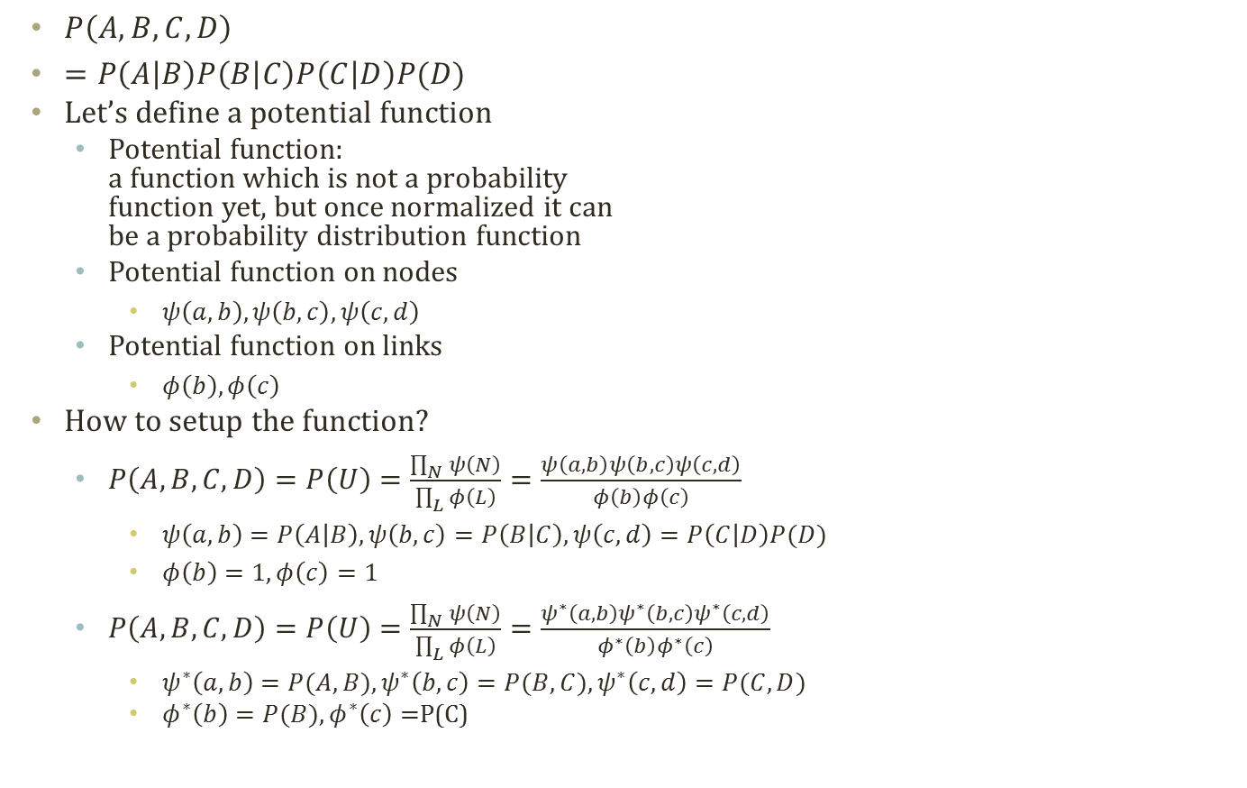
Detour: Potential Functions
$P\left(A,B,C,D\right)$
$=P\left(A | B\right)P\left(B | C\right)P\left(C | D\right)P(D)$
Let’s define a potential function
  Potential function:
  a function which is not a probability
  function yet, but once normalized it can
  be a probability distribution function
  Potential function on nodes
    $ψ\left(a,b\right),ψ\left(b,c\right),ψ\left(c,d\right)$
  Potential function on links
    $φ\left(b\right),φ\left(c\right)$
How to setup the function?
  $P\left(A,B,C,D\right)=P\left(U\right)=\frac{\prod_{N}{ψ\left(N\right)}}{\prod_{L}{φ\left(L\right)}}=\frac{ψ\left(a,b\right)ψ\left(b,c\right)ψ\left(c,d\right)}{φ\left(b\right)φ\left(c\right)}$
    $ψ\left(a,b\right)=P\left(A | B\right),ψ\left(b,c\right)=P\left(B | C\right),ψ\left(c,d\right)=P\left(C | D\right)P(D)$
    $φ\left(b\right)=1,φ\left(c\right)=1$
  $P\left(A,B,C,D\right)=P\left(U\right)=\frac{\prod_{N}{ψ\left(N\right)}}{\prod_{L}{φ\left(L\right)}}=\frac{ψ^{∗}\left(a,b\right)ψ^{∗}\left(b,c\right)ψ^{∗}\left(c,d\right)}{φ^{∗}\left(b\right)φ^{∗}\left(c\right)}$
    $ψ^{∗}\left(a,b\right)=P(A,B),ψ^{∗}\left(b,c\right)=P(B,C),ψ^{∗}\left(c,d\right)=P(C,D)$
    $φ^{∗}\left(b\right)=P(B),φ^{∗}\left(c\right)=$P(C)
A
B
C
D
A,B
B
B,C
C
C,D
Clique
Separator
Marginalization is also applicable:
$$ψ\left(w\right)=\sum_{v−w}{ψ\left(v\right)}$$
Constructing a potential of a subset (w) of all variables (v)

Slide 13
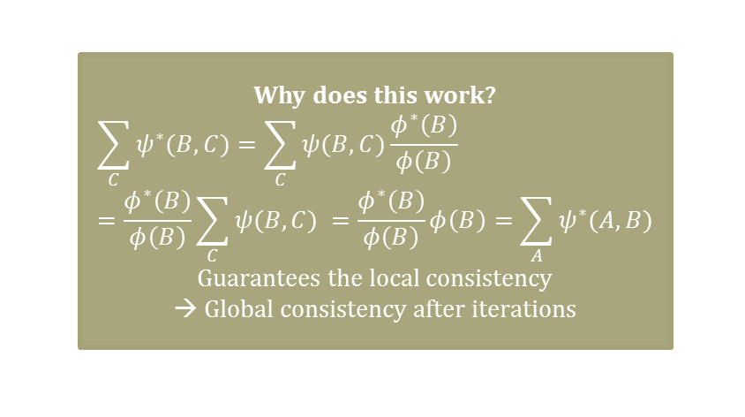
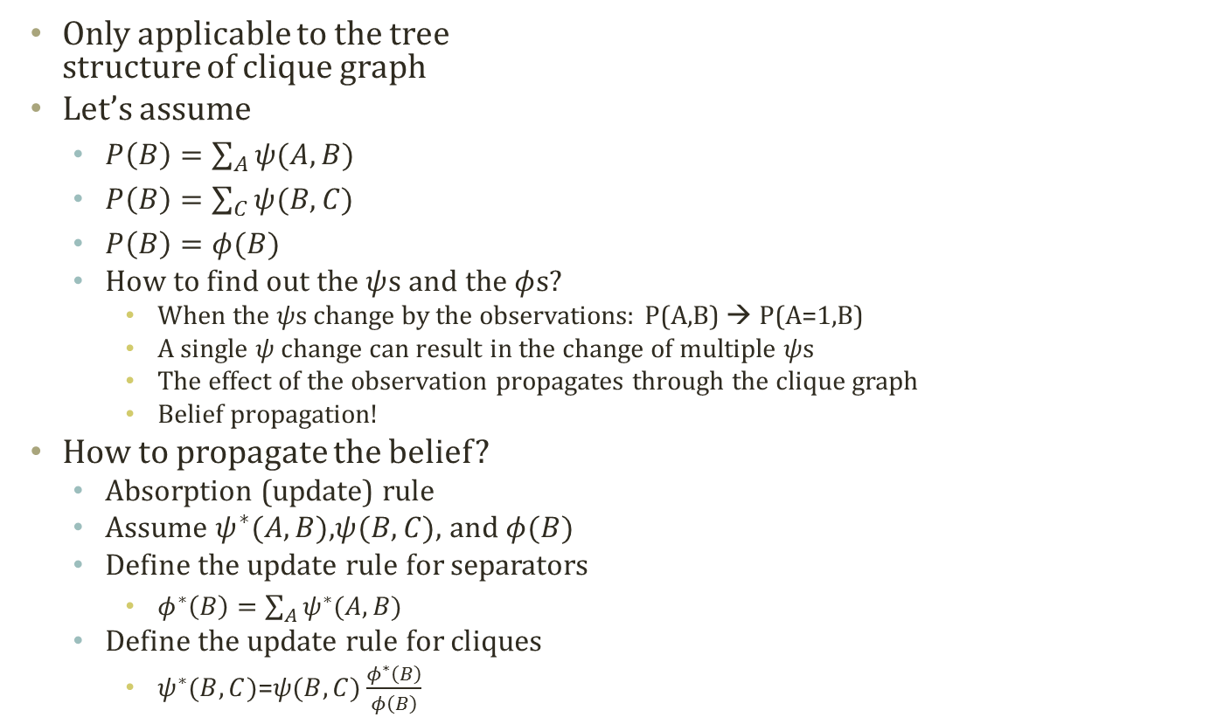
Detour: Absorption in Clique Graph
A
B
C
D
Only applicable to the tree
structure of clique graph
Let’s assume
  $P\left(B\right)=\sum_{A}{ψ(A,B)}$
  $P\left(B\right)=\sum_{C}{ψ(B,C)}$
  $P\left(B\right)=φ(B)$
  How to find out the $ψ$s and the $φ$s?
    When the $ψ$s change by the observations: P(A,B) → P(A=1,B)
    A single $ψ$ change can result in the change of multiple $ψ$s
    The effect of the observation propagates through the clique graph
    Belief propagation!
How to propagate the belief?
  Absorption (update) rule
  Assume $ψ^{∗}(A,B)$,$ψ(B,C)$, and $φ(B)$
  Define the update rule for separators
    $φ^{∗}\left(B\right)=\sum_{A}{ψ^{∗}(A,B)}$
  Define the update rule for cliques
    $ψ^{∗}(B,C)$=$ψ(B,C)\frac{φ^{∗}\left(B\right)}{φ\left(B\right)}$
A,B
B
B,C
C
C,D
Why does this work?
  $$\sum_{C}{ψ^{∗}(B,C)}=\sum_{C}{ψ(B,C)\frac{φ^{∗}\left(B\right)}{φ\left(B\right)}}=\frac{φ^{∗}\left(B\right)}{φ\left(B\right)}\sum_{C}{ψ(B,C) }=\frac{φ^{∗}\left(B\right)}{φ\left(B\right)}φ\left(B\right)=\sum_{A}{ψ^{∗}(A,B)}$$
  Guarantees the local consistency
  → Global consistency after iterations

Slide 14


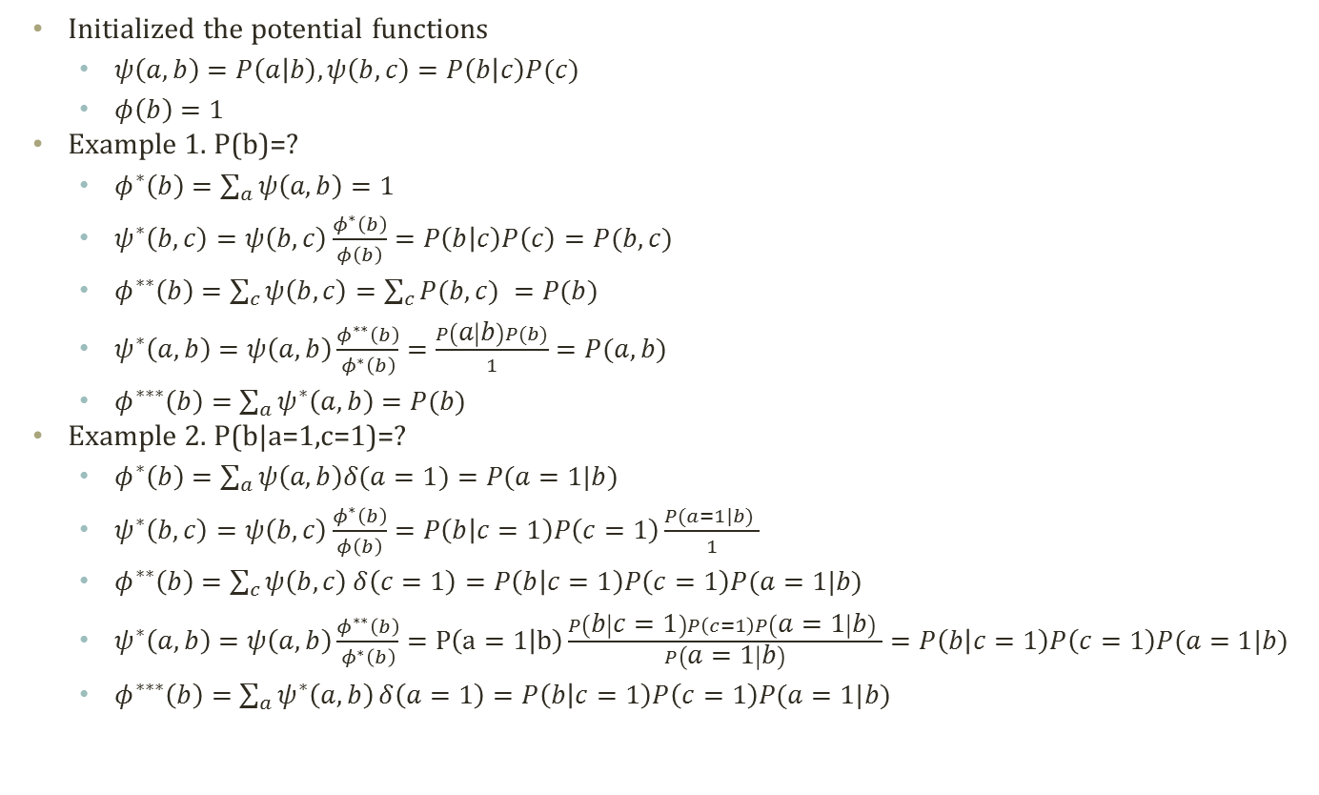



Detour: Simple Example of Belief Propagation
Initialized the potential functions
  $ψ\left(a,b\right)=P\left(a | b\right),ψ\left(b,c\right)=P\left(b | c\right)P(c)$
  $φ\left(b\right)=1$
Example 1. P(b)=?
  $φ^{∗}\left(b\right)=\sum_{a}{ψ\left(a,b\right)}=1$
  $ψ^{∗}\left(b,c\right)=ψ\left(b,c\right)\frac{φ^{∗}\left(b\right)}{φ\left(b\right)}=P\left(b | c\right)P\left(c\right)=P(b,c)$
  $φ^{∗∗}\left(b\right)=\sum_{c}{ψ\left(b,c\right)}=\sum_{c}{P(b,c) }=P(b)$
  $ψ^{∗}\left(a,b\right)=ψ\left(a,b\right)\frac{φ^{∗∗}\left(b\right)}{φ^{∗}\left(b\right)}=\frac{P\left(a | b\right)P(b)}{1}=P(a,b)$
  $φ^{∗∗∗}\left(b\right)=\sum_{a}{ψ^{∗}\left(a,b\right)}=P(b)$
Example 2. P(b|a=1,c=1)=?
  $φ^{∗}\left(b\right)=\sum_{a}{ψ\left(a,b\right)δ(a=1)}=P(a=1|b)$
  $ψ^{∗}\left(b,c\right)=ψ\left(b,c\right)\frac{φ^{∗}\left(b\right)}{φ\left(b\right)}=P\left(b | c=1\right)P\left(c=1\right)\frac{P(a=1|b) }{1}$
  $φ^{∗∗}\left(b\right)=\sum_{c}{ψ\left(b,c\right)}δ\left(c=1\right)=P\left(b | c=1\right)P\left(c=1\right)P(a=1|b)$
  $ψ^{∗}\left(a,b\right)=ψ\left(a,b\right)\frac{φ^{∗∗}\left(b\right)}{φ^{∗}\left(b\right)}=P\left(a=1 | b\right)\frac{P\left(b | c=1\right)P\left(c=1\right)P\left(a=1 | b\right) }{P\left(a=1 | b\right)}=P\left(b | c=1\right)P\left(c=1\right)P(a=1|b)$
  $φ^{∗∗∗}\left(b\right)=\sum_{a}{ψ^{∗}\left(a,b\right)}δ\left(a=1\right)=P\left(b | c=1\right)P\left(c=1\right)P(a=1|b)$
A
B
C
Bayesian Network
1) $φ^{∗}\left(b\right)$
2) $ψ^{∗}\left(b,c\right)$
4) $ψ^{∗}\left(a,b\right)$
3) $φ^{∗∗}\left(b\right)$
5) $φ^{∗∗∗}\left(b\right)$
A,B
B
B,C
Clique Graph

Slide 15
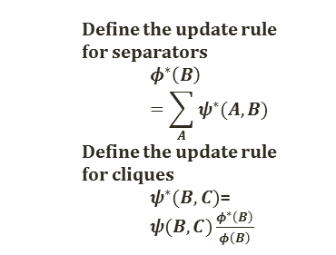
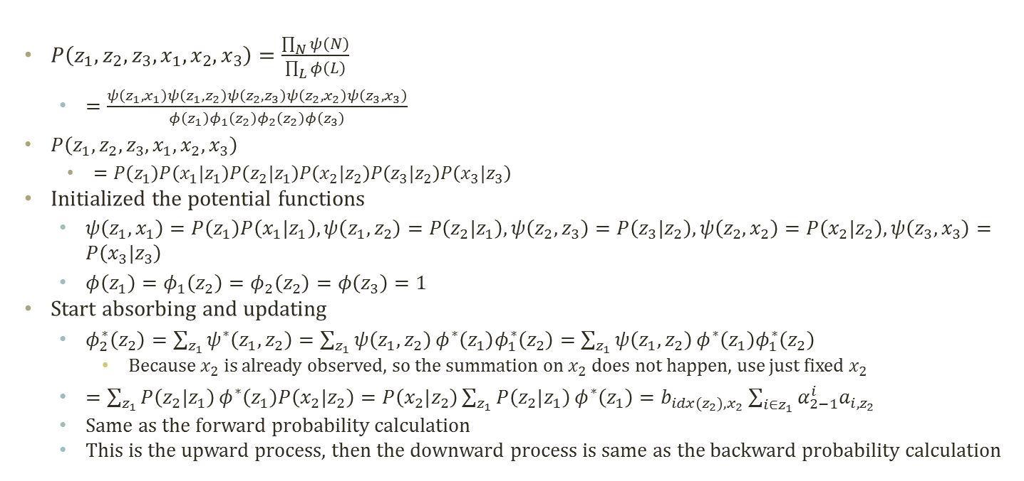



Message Passing and Forward-Backward
$$π$$
z1
z2
z3
z1, x1
z1
z1, z2
z2
z2, z3
$$φ_{2}\left(z_{2}\right)$$
$$φ_{1}\left(z_{2}\right)$$
z2
z3
x1
x2
x3
z2, x2
z3, x3
  Define the update rule for separators
    $$φ^{∗}\left(B\right)=\sum_{A}{ψ^{∗}(A,B)}$$
  Define the update rule for cliques
    $ψ^{∗}(B,C)$=$ψ(B,C)\frac{φ^{∗}\left(B\right)}{φ\left(B\right)}$
$P\left(z_{1},z_{2},z_{3},x_{1},x_{2},x_{3}\right)=\frac{\prod_{N}{ψ\left(N\right)}}{\prod_{L}{φ\left(L\right)}}$
  $=\frac{ψ\left(z_{1},x_{1}\right)ψ\left(z_{1},z_{2}\right)ψ\left(z_{2},z_{3}\right)ψ\left(z_{2},x_{2}\right)ψ\left(z_{3},x_{3}\right)}{φ\left(z_{1}\right)φ_{1}\left(z_{2}\right)φ_{2}\left(z_{2}\right)φ\left(z_{3}\right)}$
  $P\left(z_{1},z_{2},z_{3},x_{1},x_{2},x_{3}\right)$
    $=P\left(z_{1}\right)P\left(x_{1}|z_{1}\right)P\left(z_{2}|z_{1}\right)P\left(x_{2}|z_{2}\right)P\left(z_{3}|z_{2}\right)P\left(x_{3}|z_{3}\right)$
Initialized the potential functions
  $ψ\left(z_{1},x_{1}\right)=P\left(z_{1}\right)P\left(x_{1}|z_{1}\right),ψ\left(z_{1},z_{2}\right)=P\left(z_{2}|z_{1}\right),ψ\left(z_{2},z_{3}\right)=P\left(z_{3}|z_{2}\right),ψ\left(z_{2},x_{2}\right)=P\left(x_{2}|z_{2}\right),ψ\left(z_{3},x_{3}\right)=P\left(x_{3}|z_{3}\right)$
  $φ\left(z_{1}\right)=φ_{1}\left(z_{2}\right)=φ_{2}\left(z_{2}\right)=φ\left(z_{3}\right)=1$
Start absorbing and updating
  $φ_{2}^{∗}\left(z_{2}\right)=\sum_{z_{1}}{ψ^{∗}\left(z_{1},z_{2}\right)}=\sum_{z_{1}}{ψ\left(z_{1},z_{2}\right)}φ^{∗}\left(z_{1}\right)φ_{1}^{∗}\left(z_{2}\right)=\sum_{z_{1}}{ψ\left(z_{1},z_{2}\right)}φ^{∗}\left(z_{1}\right)φ_{1}^{∗}\left(z_{2}\right)$
    Because $x_{2}$ is already observed, so the summation on $x_{2}$ does not happen, use just fixed $x_{2}$
  $=\sum_{z_{1}}{P\left(z_{2}|z_{1}\right)}φ^{∗}\left(z_{1}\right)P\left(x_{2}|z_{2}\right)=P\left(x_{2}|z_{2}\right)\sum_{z_{1}}{P\left(z_{2}|z_{1}\right)}φ^{∗}\left(z_{1}\right)=b_{idx(z_{2}),x_{2}}\sum_{i∈z_{1}}{α_{2−1}^{i}a_{i,z_{2}}}$
  Same as the forward probability calculation
  This is the upward process, then the downward process is same as the backward probability calculation
Initial State probabilities
  $$P(z_{1})∼Mult(π_{1},…,π_{k})$$
Transition probabilities
  $$P(z_{t}|z_{t−1}^{i}=1)∼Mult(a_{i,1},…,a_{i,k})$$
  Or, $P\left(z_{t}^{j}=1 | z_{t−1}^{i}=1\right)=a_{i,j}$
Emission probabilities
  $$P\left(x_{t} | z_{t}^{i}=1\right)∼Mult\left(b_{i,1},…,b_{i,m}\right)$$
  Or, $P\left(x_{t}^{j}=1 | z_{t}^{i}=1\right)=b_{i,j}$

